Slide 1
First Gym Time
Studio 1, Sem 01 2018
MAGI-Masters of Animation, Games and Interactivity
^{Yifan Sun}
Masters of Animation, Games and Interactivity (MAGI),
^{School of Design,}
^{RMIT University,}
^{Melbourne, Australia}
^{s3690577@rmit.edu.au}

Slide 2
Background
Studio 1, Sem 01 2018
MAGI-Masters of Animation, Games and Interactivity
One day I went to Gym without my earphone.
I was surprised by the strong guys' moaning.
It was so improper in public.
If I was totally no-experienced in gym, I would certainly be terrified.

Slide 3
Authors Keywords
Studio 1, Sem 01 2018
MAGI-Masters of Animation, Games and Interactivity
Facial Expression
Misleading the audience from the fact.
Sense of failure for the audience.
While the main character feels good about him/ her self.

Slide 4
Step 1: IDEAS
Studio 1, Sem 01 2018
MAGI-Masters of Animation, Games and Interactivity
I want to express the feel I feel the moment I stepped into the room. So the surrounding people are very important.
Express how a starter feels. Even we could only do a little weight.

Slide 5
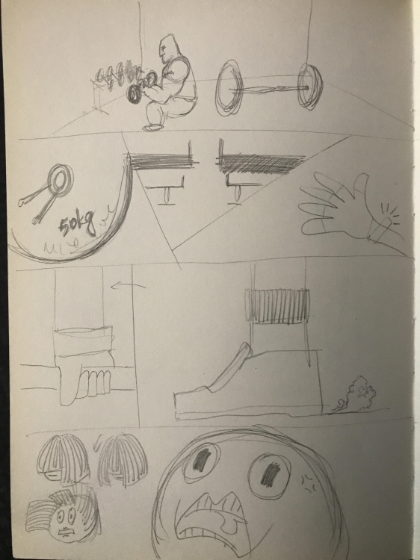
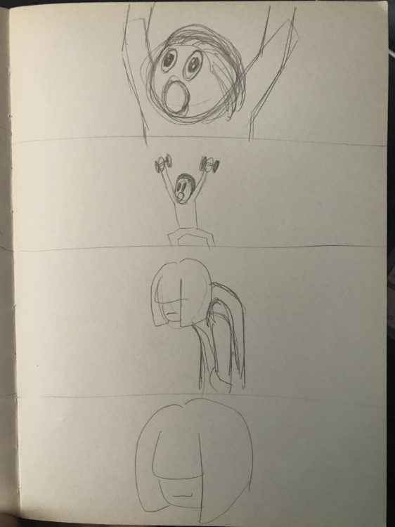
Step 2: Storyboard
Studio 1, Sem 01 2018
MAGI-Masters of Animation, Games and Interactivity

Slide 6
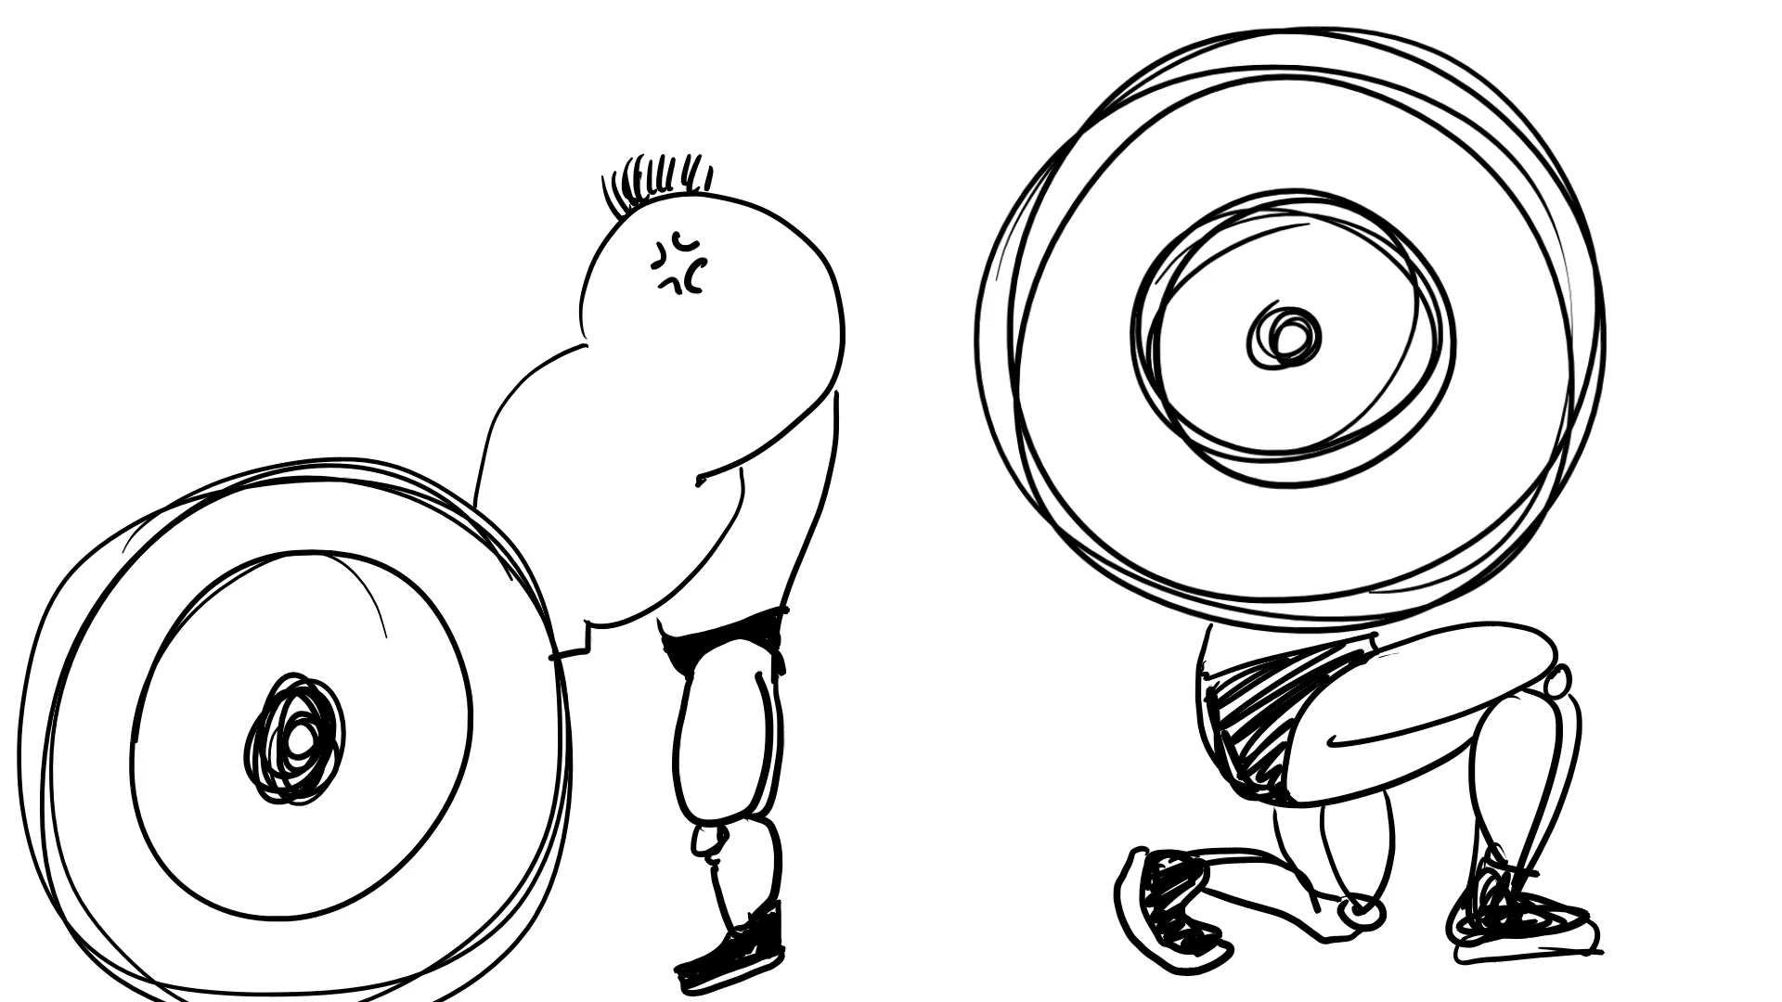
Step 2: Storyboard
Studio 1, Sem 01 2018
MAGI-Masters of Animation, Games and Interactivity

Slide 7
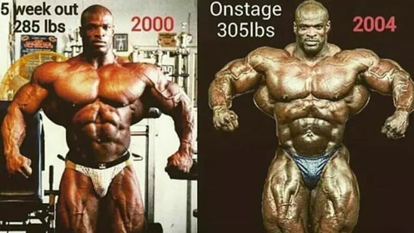
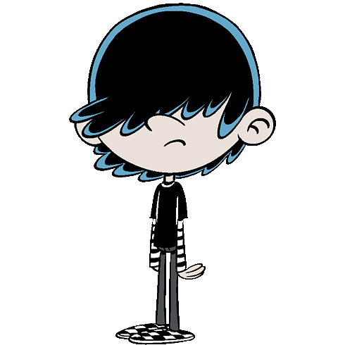
Reference: Steroid-user & Skinny fat
Studio 1, Sem 01 2018
MAGI-Masters of Animation, Games and Interactivity
Step 3: Characters

Slide 8
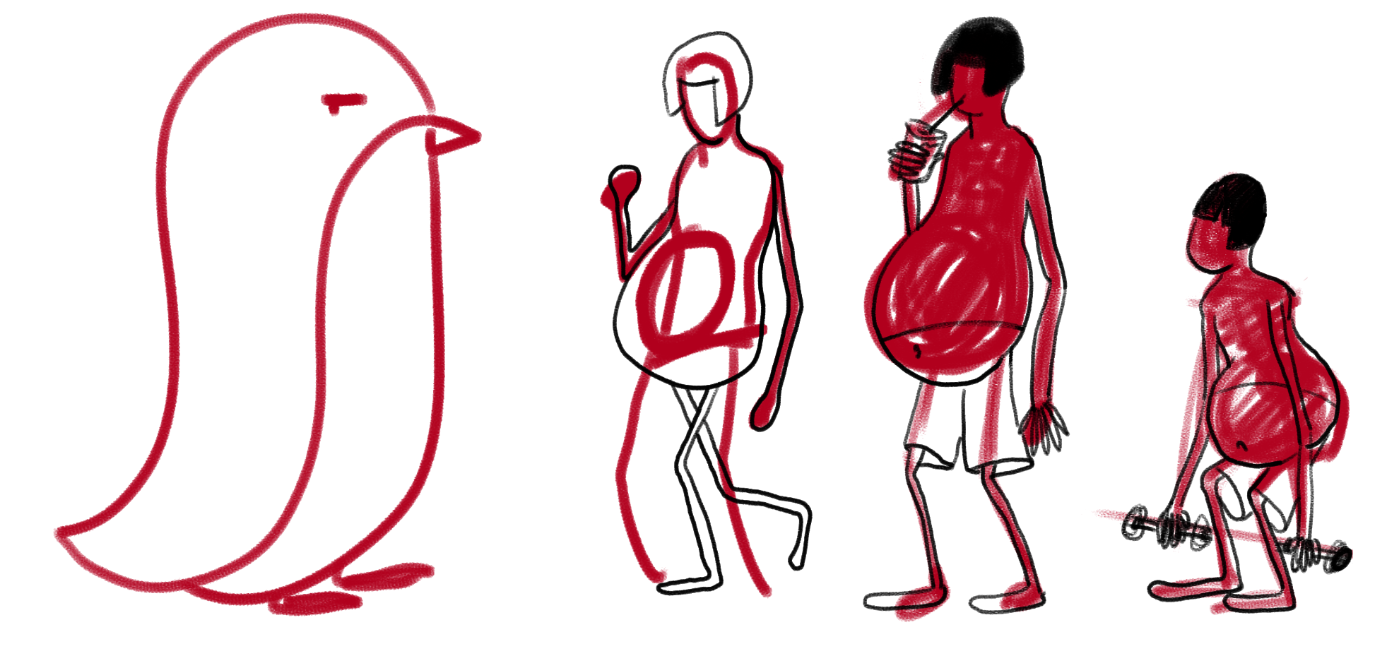
Step 3: Characters
Studio 1, Sem 01 2018
MAGI-Masters of Animation, Games and Interactivity
1. Main character should be a skinny fat guy.

Slide 9
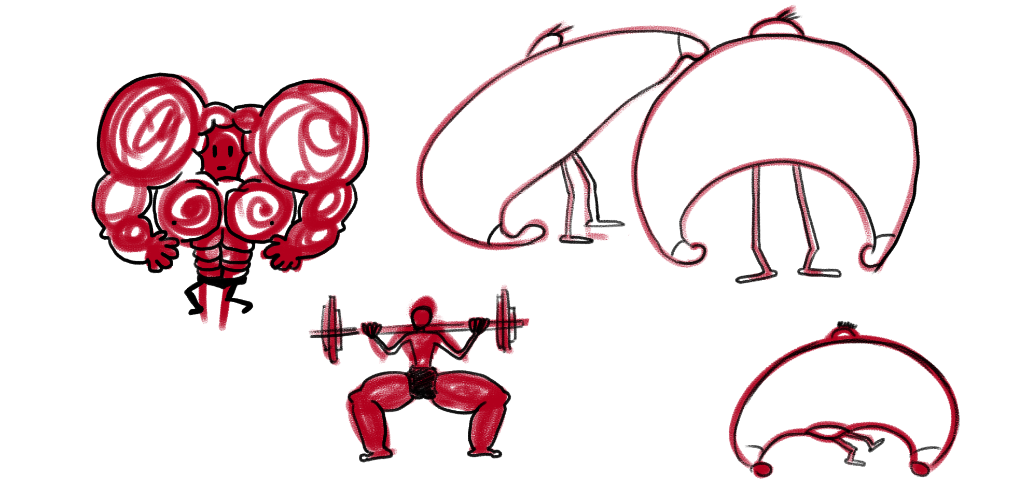
Step 3: Characters
Studio 1, Sem 01 2018
MAGI-Masters of Animation, Games and Interactivity
2. The surrunding character should be suuuuuper strong.

Slide 10
Step 4: Details on head waving
Studio 1, Sem 01 2018
MAGI-Masters of Animation, Games and Interactivity
Reference
https://www.bilibili.com/video/av27054416/
https://www.bilibili.com/video/av17434676/
https://youtu.be/0znJS8qbtVM
A home made slow-motion video
which is not proper to play in public.

Slide 11
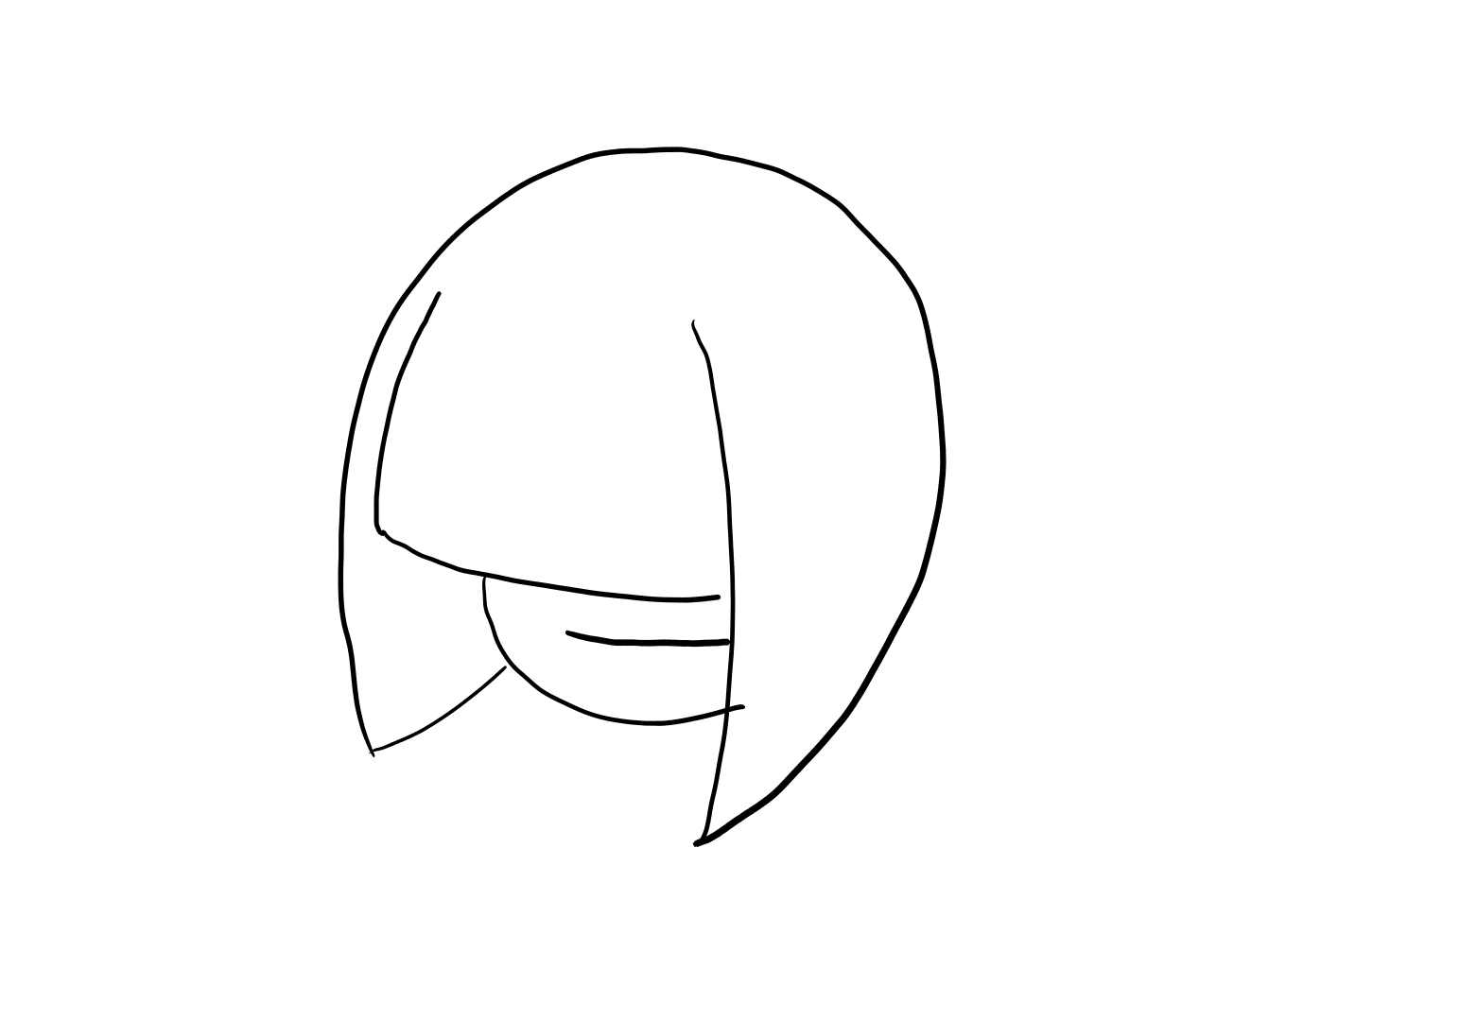
Step 4: Details on head waving
Studio 1, Sem 01 2018
MAGI-Masters of Animation, Games and Interactivity

Slide 12
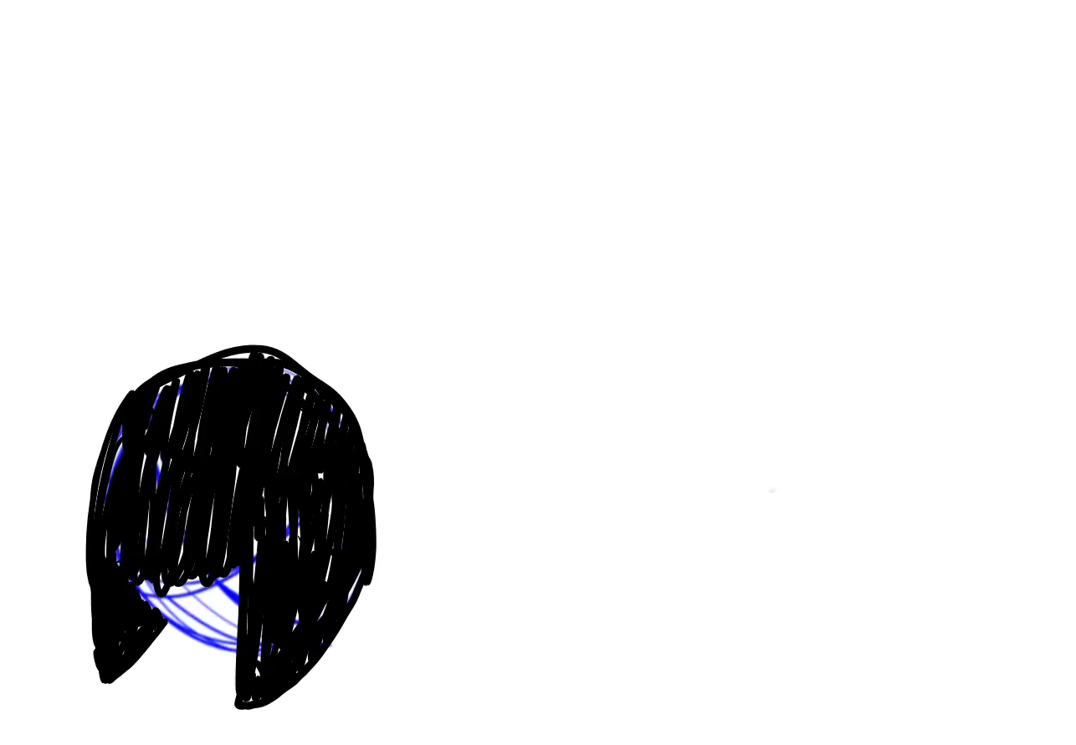
Step 4: Details on head waving
Studio 1, Sem 01 2018
MAGI-Masters of Animation, Games and Interactivity

Slide 13
To-Do List
Studio 1, Sem 01 2018
MAGI-Masters of Animation, Games and Interactivity
Main
Character
Strong
Character
Gym
Surroundings
Make the motion more smooth
Timing of his/her action
Check more ways to express the feel of surprised
Take more reference tapes in gym
Maybe recording some sound of their trainings
Exaggerate the size
Symbolize the surrounding

