Slide 1


Animated Narratives//
Week 2
Nick Flanders-Farmer
S3888343
MAGI @RMIT

Slide 2

Themes & Concepts
Loneliness in Belonging/Belonging in Loneliness
Finding purpose, finding fulfillment
Death and Legacy
Nostalgia and Forgotten Times

Slide 3
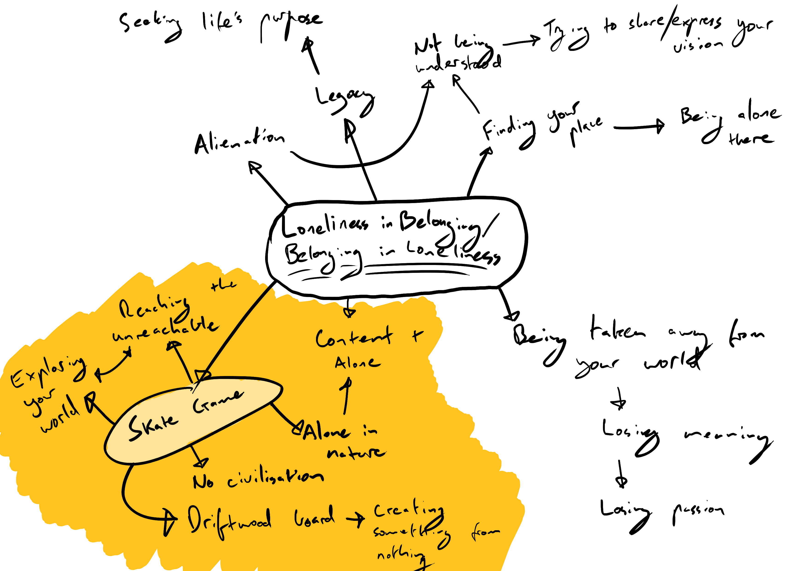
Concept Mind-Map
As a conceptual exercise we were tasked with creating a free-flowing mind-map.
I centered mine around a core theme, ‘Loneliness in Belonging/Belonging in Loneliness’. From here I explored ways loneliness and belonging intertwine, and how the two shape us.
I then tied this idea to a concept for a video game I have been developing in my head. I would like to explore this topic through literal exploration in a video game about loneliness, isolation, and finding your place.

Slide 4


Developing Premises
From our mind-maps we were tasked with picking the most fertile concepts and developing a series of short premises or concepts we could potentially develop.

Slide 5

A nomadic Mercenary is tasked with a covert mission by the US Government and forced to do their bidding to be reunited with his adopted daughter. He fails the mission on purpose, undoing a global conspiracy and giving his daughter a better future without him.
A young boy is sent out into the wilderness in a right of passage on a journey to self discovery. After conquering mountainous terrain and arid deserts the boy, now a man, accepts a life of isolation and finds his place in nature.
An old baker discovers his love of cooking obscure, niche dishes. He struggles to establish a business as a chef, creating weird and wonderful food for the adventurous and create a legacy. He finds a footing as a private chef for a wealthy executive and is given carte blanche to explore his vision for dinner guests.

Slide 6

What if…
As our Weekly Wiki Premise we were tasked with constructing a premise in the form of a ‘What if?’ question.
“What if nuclear energy had never been discovered?”
This premise could spark a narrative exploring an alternate end to World War 2 and the course of the 20th and 21st Centuries. In this world nuclear weapons and power plants would not exist, likely leading to a radically different world to what we know today.
This premise was partially inspired by the Metal Gear series (Konami, 1987), which chronicles the history and influence of nuclear weapons and nuclear power from the early 20th Century to the modern day. The series poses the opposite question, exploring the possibilities of a modern society driven by nuclear war and nuclear-powered machines of war.

